Slide 1
Hard Facts ....
54 Ha of Crown Land left – 22 MCG arenas
Contaminated Service Station and Engine Workshop at 2 Station Street sold in May 2010 for $4.2 m - $2,814/sqm.
The TAB triangle is 5,867sqm = $16,509,738
However the land swap netted the State Government only $4,500,00!
government of the people, by the people, and for the people

Slide 2
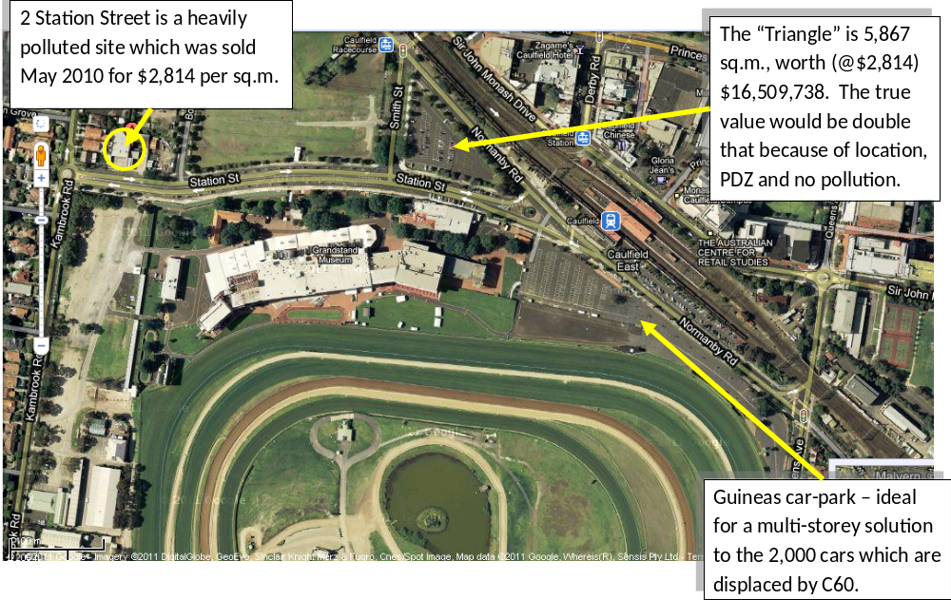
No financial details are available from the Valuer-General, but it certainly is a great deal for the MRC

Slide 3
Development Levy
Council has said we would be pleased to receive $3 million as development levy payment for C60.
C60 covers 57,200 sq.m. and, at only $2814/sq.m., it is worth $160,960,800.
5% development levy equates to $8,048,040 – and that’s at last year’s polluted land value. Once C60 is passed the land would double in value, so Council should be expecting $16million. That will go a long way towards paying off Council’s expected bank loan!
Why this very serious discrepancy? Is it $16 million plus or $3 million minus?

Slide 4
The Problem:
All 54 ha of this valuable land is dominated by thoroughbred racing. It should be shared by the public. Horses are dangerous animals, and must be separated from the public.
The public is desperately short of passive and active open space.

Slide 5
The Solution:
Separate the horses from the public & provide BOTH with exclusive areas AND exclusive access to those areas!
It’s not rocket science – but it does involve thinking outside the square.
So how do we do it?

Slide 6
Horses now dominate the 54 ha but they don’t much use the
15 ha inside the training tracks - “the flat”
The most convenient public access to the flat is via a tunnel off Glen Eira Road, but it is used by the horses until 9.30 am.

Slide 7
The Tunnel
Is 250 metre long, smelly, dirty, muddy and dusty
Why can’t the horses access the six training tracks directly from their stables, which are located around the outside of the track? This works for most racetracks in the world.

Slide 8
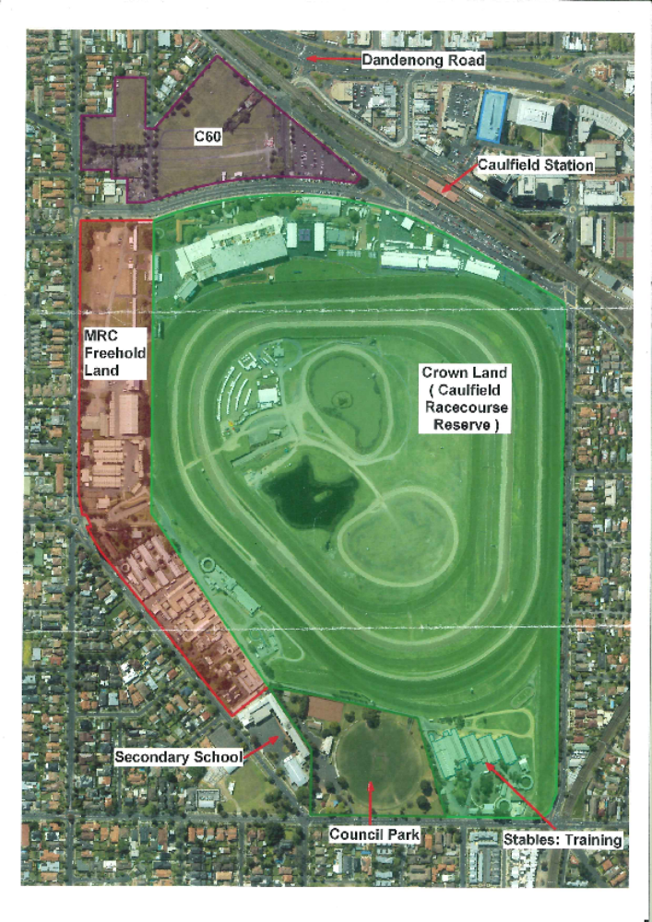
Where are the stables located?
The brown is freehold abutting the Crown Land. These stables pay rent to the MRC
More stables are located on Crown Land off Neerim Road and east of the freehold land. They also pay rent to the MRC.

Slide 9
Access for training
At present all horses access the training tracks via the tunnel. This is poor OH&S practice.
They still have to circumnavigate around the “trainers’ box” and then cross over several training tracks to access the one with the particular conditions which they require (dirt or grass, fast or slow etc.)
All of the horses and their trainers are focused at the single location - the trainers’ tower.

Slide 10
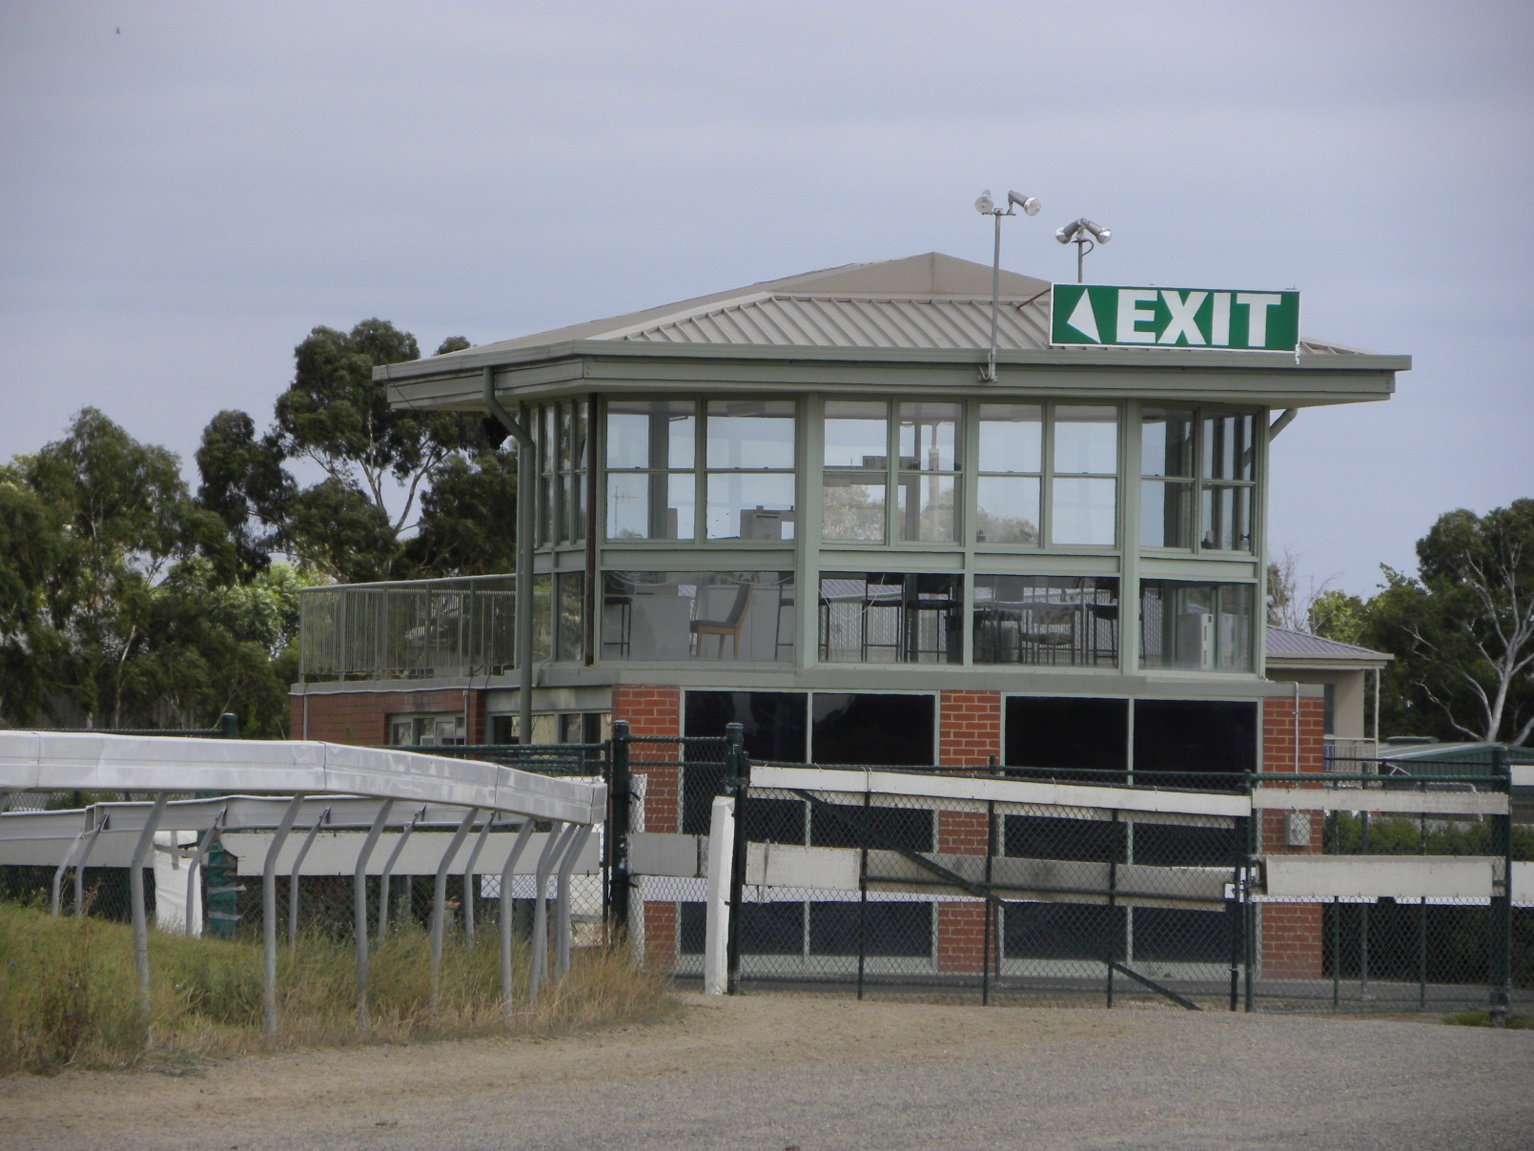
All horses circumnavigate this trainers’ tower and walk back 100 metres to the outside training track. Most trainers don’t even use the tower.

Slide 11
Tired before they reach the training track!
In particular the horses stabled on the south-eastern Crown Land (Neerim Road) have to walk almost ¾ of a kilometre to even reach the training tracks.
Why not access the training tracks directly opposite their stables?
If it works for most tracks around the world. Pre-1990 it worked for Caulfield. It will work for the 200 stabled at Neerim Road.

Slide 12
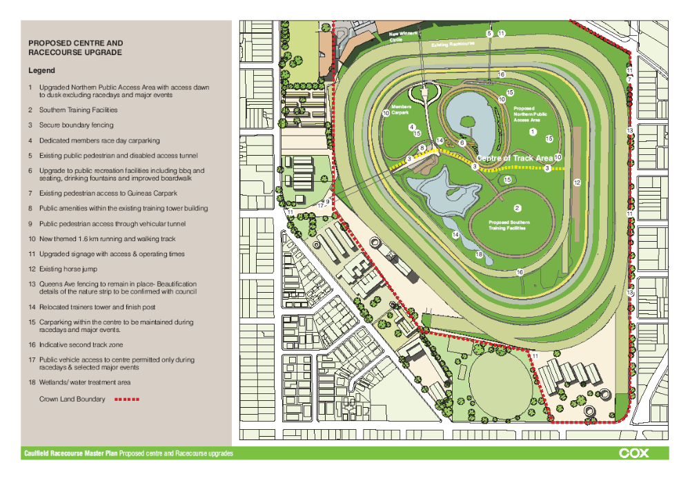
Every horse going to training from the Neerim Road stables has to follow the yellow line to the training tracks. How much easier to follow the red line straight across the actual racetrack.

Slide 13
It works everywhere else
So why not allow the three distinct groups of trainers to access the training tracks opposite their stables? – see blue arrows in the next slide.
It would be simpler and more convenient, and would allow each trainer better access to his horses. If necessary a small trainers’ tower could be erected at each of the three location.

Slide 14
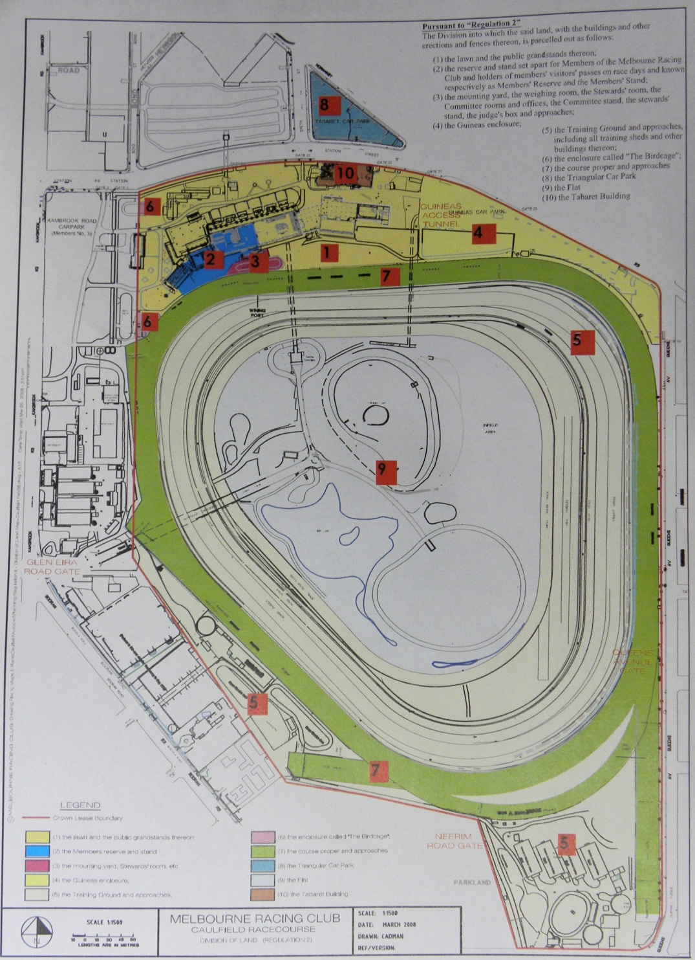
Leases & sub-leases.
The area actually leased to the MRC is that coloured yellow on their plan.
Their “sub-leases” of the Crown Land for stables are illegal.

Slide 15
Car-parking or public park?
Two thousand cars will be displaced by the C60 PDZ.
The MRC originally proposed a multi-level commercial car-park to be shared with VicRail and Monash University – as shown on the next slide, which is a picture of the model of their previous proposal. There have been many proposals.

Slide 16
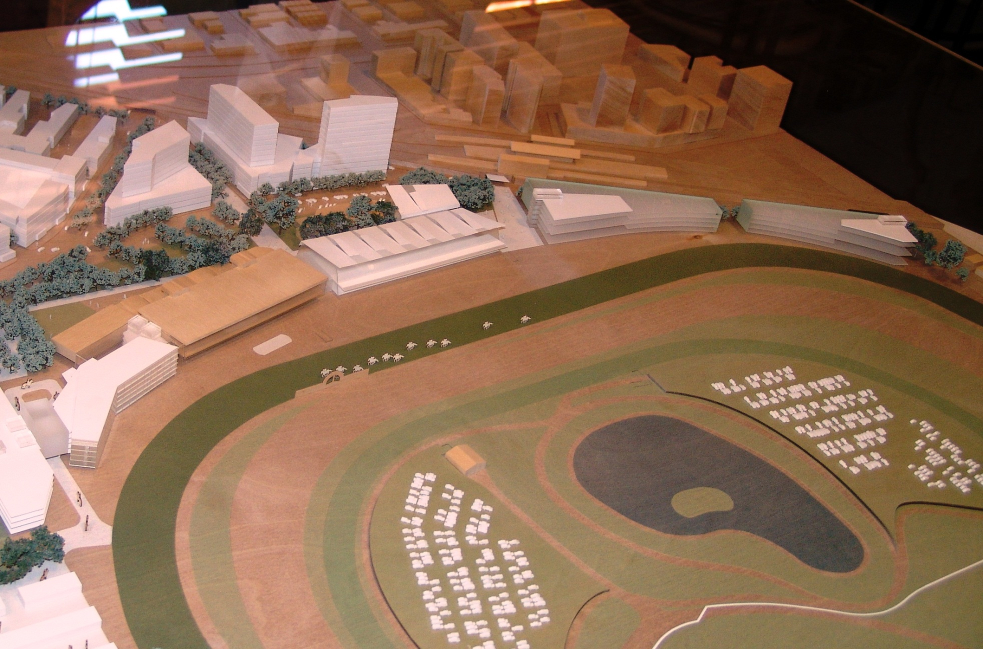
Note the proposed multi-storey car-parking on the right (Guineas car-park area) and the low-rise towers situated on the “triangle” land. This is now proposed to be of “unlimited height”

Slide 17
How many proposals must we analyse?
Multi-storey car-parking on the land known as the Guineas Car-park is absolutely essential.
Did you also notice how this earlier version of C60 had no buildings above 10 storeys? There were no “skyscrapers” on the Monash site either.

Slide 18
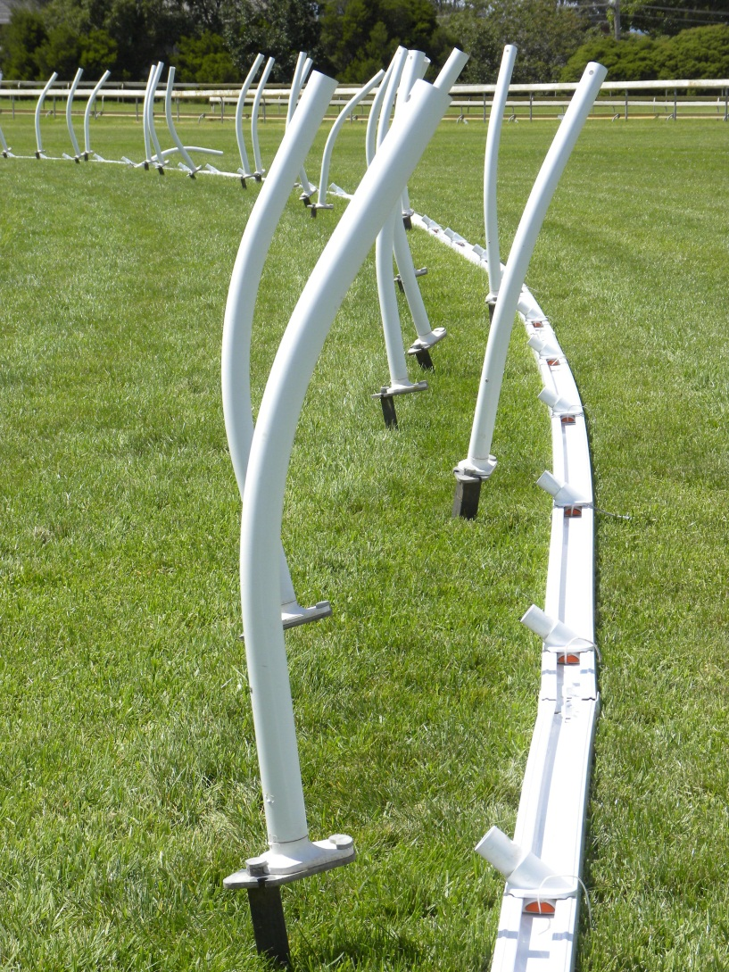
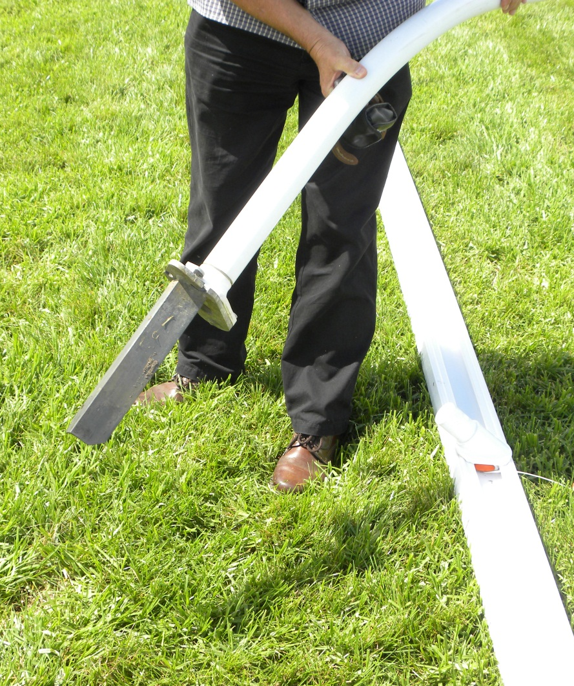
Running Rails are no longer wooden post-and-rail fixtures, but can be easily moved. The posts push in under foot pressure and the rail slots on top. Access into the track is now just so easy!

Slide 19
Finally, the infamous tunnel was BUILT FOR CARS, NOT HORSES!
Prior to the tunnel (1989) cars parking on the flat entered from Neerim or Glen Eira Roads, with a protective cover over the actual racetrack. Most racecourses in the world still do this. WHY NOT AT CAULFIELD?

Slide 20
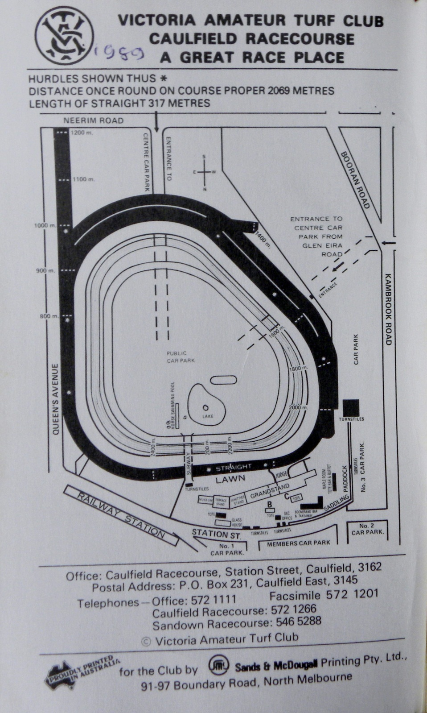
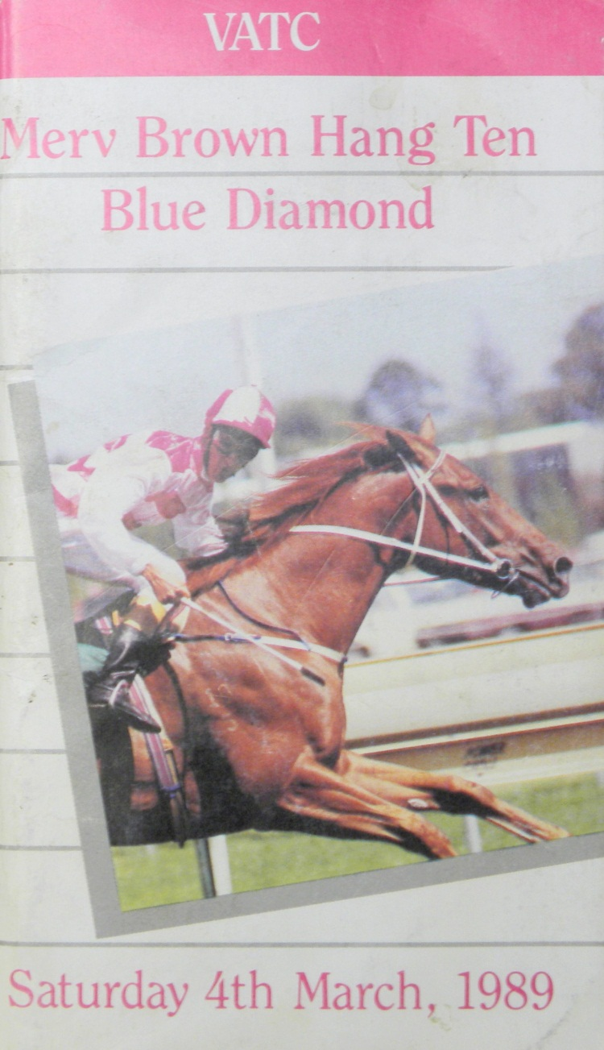
1989 – cars drive across the racetrack.
.

Slide 21
Car entry for MRC race-meetings and Special Events
1989 VATC Blue Diamond Racebook indicates cars driving across the race-track at both Neerim and Glen Eira Roads. This would give them direct access to the centre of the course parking for over 1,000 cars on the land used for horse training.
This would enable the tunnel to be cleaned up and properly maintained for the EXCLUSIVE use of the MRC’s maintenance vehicles AND the public as pedestrians or in their own vehicles.

Slide 22
Race-day & Special Event Parking
Parking on “the flat” would be exclusively on the outer training tracks. The area is some 50% larger than that reserved for the public (inside the training tracks).
Patrons with cars parked facing the ambulance track could stay with their vehicles, and would pay a premium for the privilege.
Portable toilets would service their needs, and as happens at Flemington during the Spring Carnival patrons could be escorted to and from the grandstand area between races.

Slide 23
Whacko!
So with training gone from the tunnel AND the flat, the new $2 million “recreation ground and public park” can be open for the public 24 hours a day, seven days a week. Whacko!

Slide 24
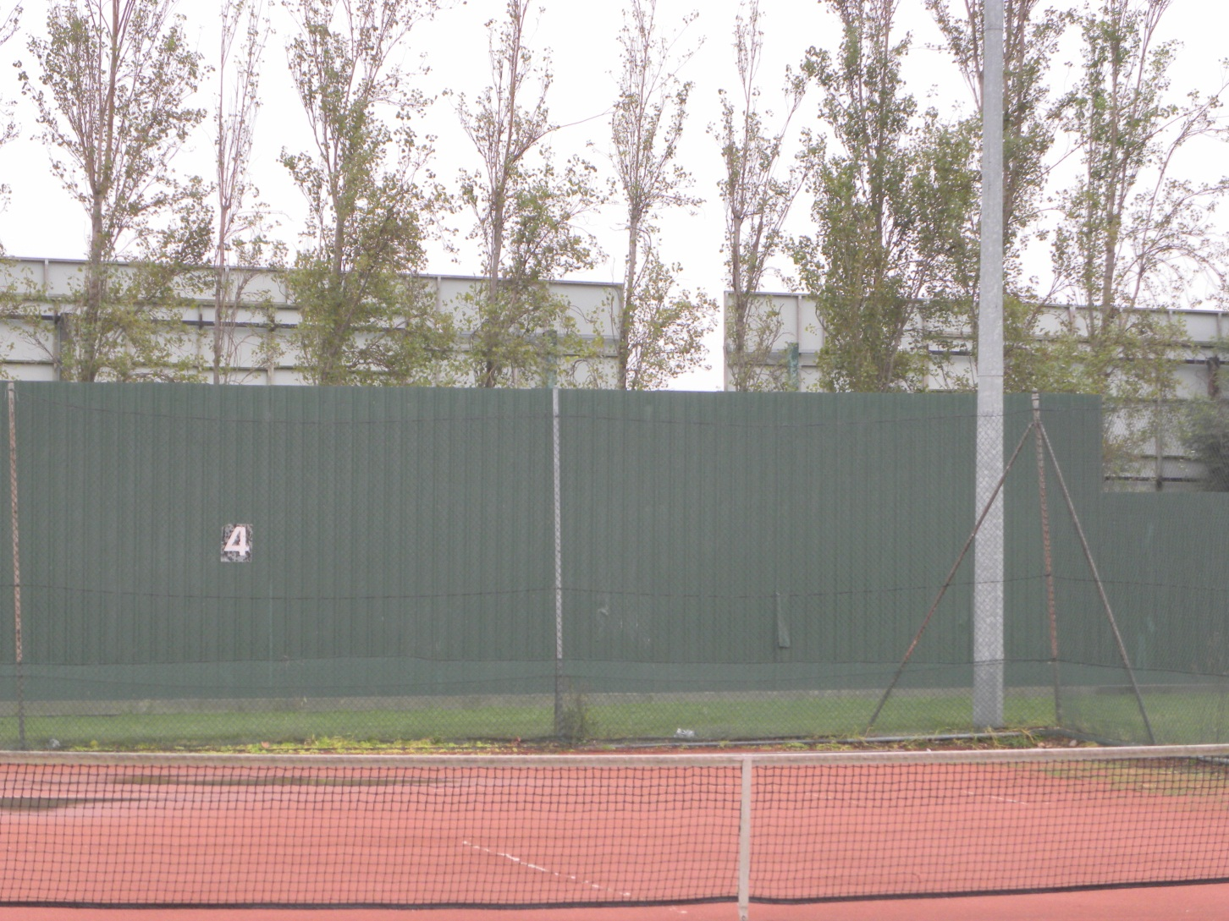
A tennis court style fence can unobtrusively separate the flat from the training tracks, although the advertising hoardings and fence will have to go.

Slide 25
What part of a “racecourse” don’t you understand?
The caravan and camping show is a wonderful money-making “special event” (for the not-for-profit MRC), BUT it IS NOT any part of a modus operandi of a racecourse.
The CRR Trustees must decide this issue, but if it stays the public should receive some financial benefit, as was strongly suggested by the Upper House Select Committee.

Slide 26
Who benefits from the CRR?
Similarly the other commercial uses of this 58 ha of Crown land – such as receptions, conventions, uni exams, car parking and administration.
It is relevant to note that the only “community beneficiary” of this Crown Land WAS Golden Days Radio, but after searching the entire 58 ha the MRC was unable to find them alternative studio accommodation when the grandstand was demolished. The MRC manages, however, to provide accommodation for the administration of their own hotel and racecourse empire.

Slide 27
Community Fund Part 1
Instead of tax, not-for-profit clubs like the MRC return 8.33% of turnover to the community.
Caulfield Racecourse TAB pokies contributed $3,966,931 in 2009. However 99.9% went on three items:
The cost of providing and maintaining the club’s sporting facilities (watering the grass);
Capital expenditure; and
General operating costs.
A measly $1,183 was donated to disaster relief, and $2,400 of the fund to pay their auditors.
"to ensure transparency and accountability in Council decision making."

Slide 28
Community Fund Part 2
Sandown’s Community Fund of over $2 million goes the same way – nowhere near the public.
Commercial TAB’s like Zagame’s pay this levy as a State Government Tax, giving the MRC a huge, unfair commercial advantage.
The MRC’s TAB’s ARE commercial operations and they ARE NOT linked to racing. They do not pay rent or tax, and Glen Eira Council should offer to take this $4 million community fund off their hands immediately.

